Slide 1
Chapter 14
Break Song

Slide 2
SQLite DB
小型資料庫
MAX COLUMN 32767
MAX ROW 2⁶⁴
MAX DB Size 140TB
Notes:
https://www.sqlite.org/limits.html

Slide 3
SQLiteOpenHelper
@Override
public void onCreate(SQLiteDatabase db) {
// Create table schema
db.execSQL("create table " + CrimeDbSchema.CrimeTable.NAME);
}
@Override
public void onUpgrade(SQLiteDatabase db, int oldVersion, int newVersion) {
// Detect version number, if get higher version, then do something
}

Slide 4
getWritableDatabase
public class CrimeLab {
private static CrimeLab sCrimeLab;
private List<Crime> mCrimes;
private Context mContext;
private SQLiteDatabase mDatabase;
...
private CrimeLab(Context context) {
mContext = context.getApplicationContext();
mDatabase = new CrimeBaseHelper(mContext)
.getWritableDatabase();
mCrimes = new ArrayList<>();
}

Slide 5
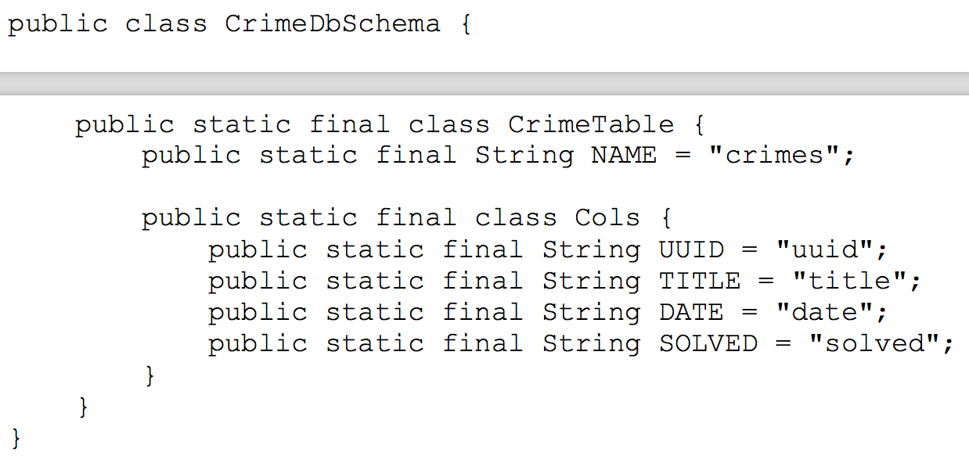
SQLite Schema

Slide 6
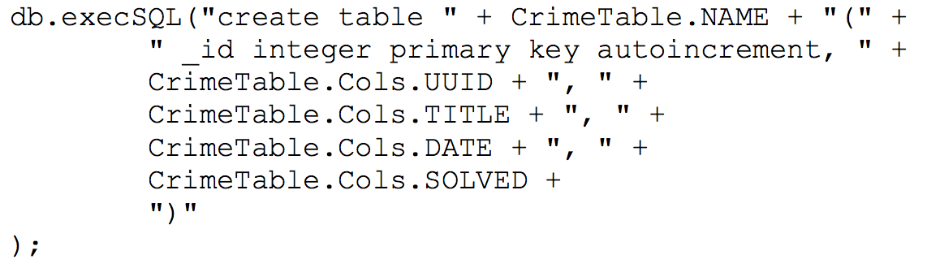
SQLite Schema (in SQLiteOpenHelper onCreate)

Slide 7
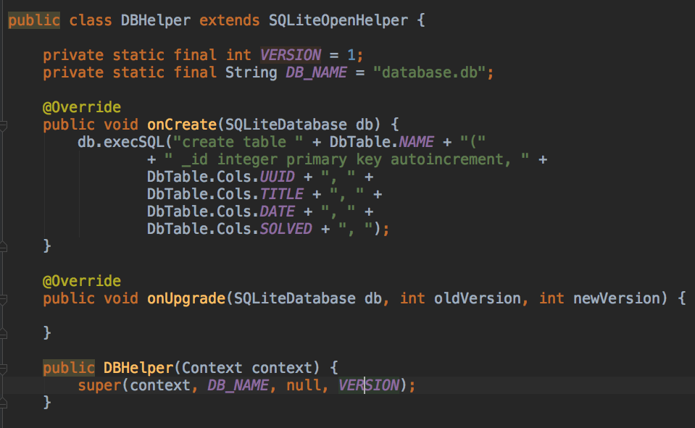
SQLiteOpenHelper

Slide 8
DB file
Located in data/data/<app_name>/databases/<db_name>.db

Slide 9
Select / Insert
public Cursor SelectAll() {
SQLiteDatabase db = this.getReadableDatabase();
return db.query(DbSchema.DbTable.NAME, null, null, null, null, null, null);
}
Note :query(String table, String[] columns, String selection, String[] selectionArgs, String groupBy, String having, String orderBy)
public long insert(String field_title, String value) {
SQLiteDatabase db = this.getWritableDatabase();
ContentValues cv = new ContentValues();
cv.put(field_title, value);
return db.insert(DbSchema.DbTable.NAME, null, cv);
}
Notes:
Insert nullColumnHack 表示當insert為空直的contentvalues時 需要指定一個欄位為null方可插入

Slide 10
Update / Delete
public int delete(String condition, String[] values) {
SQLiteDatabase db = this.getWritableDatabase();
String where = condition;
String[] whereValue = values;
return db.delete(DbSchema.DbTable.NAME, where, whereValue);
}
public void update(String condition, String[] conditionValue, String field_title, String value) {
SQLiteDatabase db = this.getWritableDatabase();
String where = condition;
String[] whereValue = conditionValue;
ContentValues cv = new ContentValues();
cv.put(field_title, value);
db.update(DbSchema.DbTable.NAME, cv, where, whereValue);
}

Slide 11
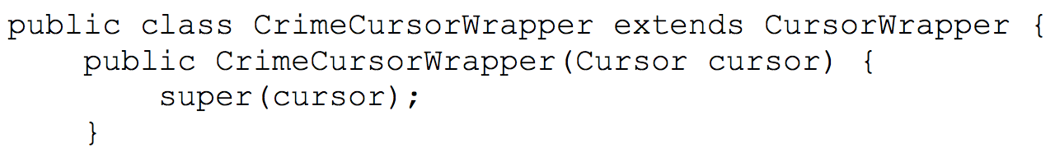
CursorWrapper
Notes:
Extend Object implements Cursor

Slide 12
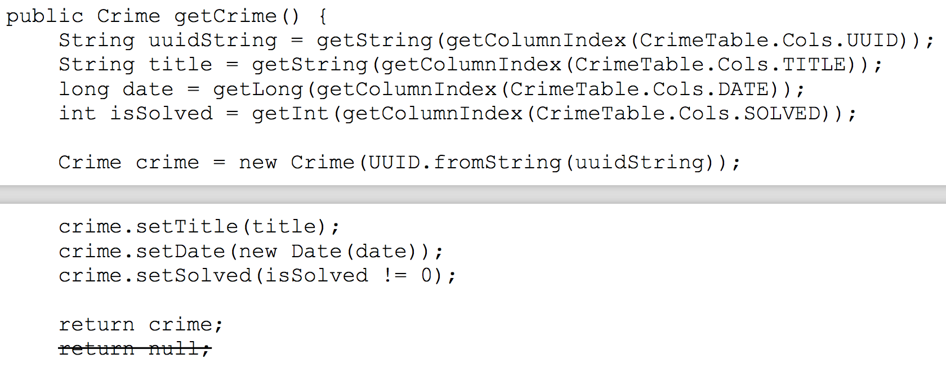
CursorWrapper - getCrime

Slide 13
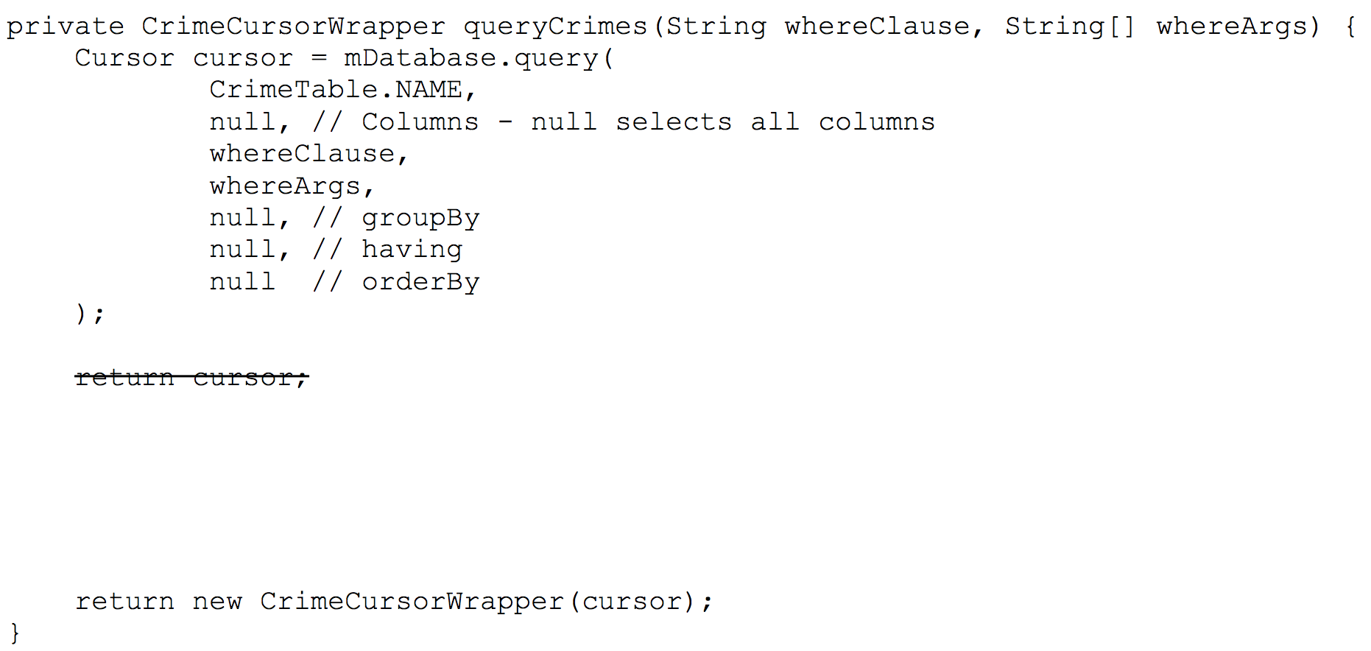
CrimLab - queryCrimes

Slide 14
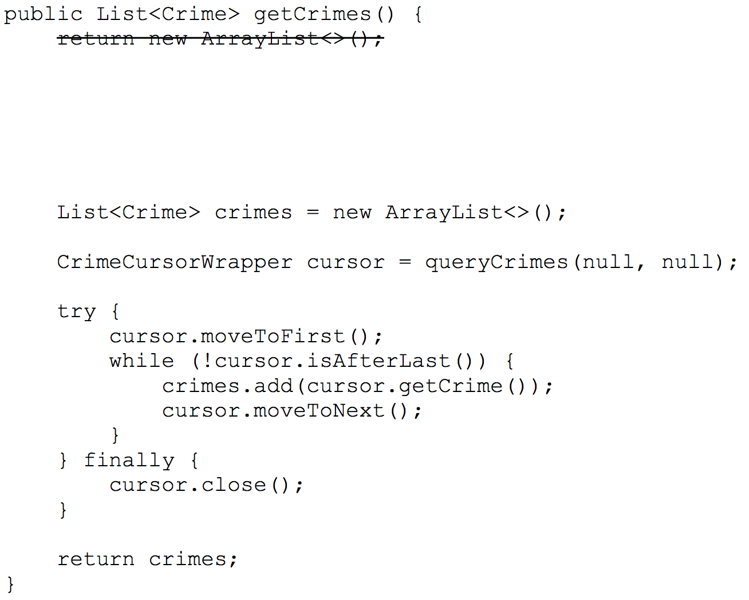
CrimLab - getCrimes

